Slide 1
MCQ

Slide 2
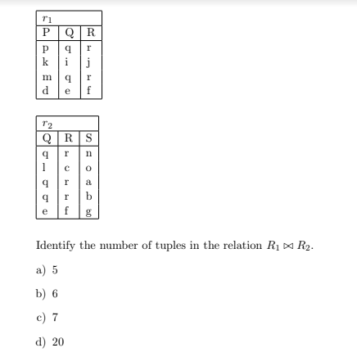

Slide 3
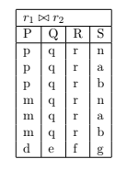

Slide 4
In SQL, which of the following is/are not a DML Commands?.
A)DELETE
B) TRUNCATE
C) CREATE
D)UPDATE

Slide 5
Identify the correct statement about Foreign Key.
a) A data element/attribute within a data field of a data record that is not unique, and cannot be used to distinguish one data record in a database from another data record within a database table.
b) A data element/attribute within a data field of a data record within a database table that is a secondary key in another database table.
c) A data element/attribute within a data field of a data record within a database table that is a primary key in another database table.
d) A data element/attribute within a data field of a data record that enables a database to uniquely distinguish one data record in a database from another data record within a database table.

Slide 6
Information about a collection of students is given by the relation
studinfo(studId, name, sex)
The relation
enroll(studId, courseId)
gives which student has enrolled for (or taken) what course(s). Assume that every course is
taken by atleast one male and at least one female student. What does the following relational
algebra expression represent?
ΠcourseId((ΠstudId(σsex=”female”(studInfo)) × ΠcourseId(enroll)) − enroll)
a) courses in which all the female students are enrolled
b) courses in which a proper subset of female students are enrolled
c) courses in which only male students are enrolled
d) None of the above

Slide 7
Identify the valid data-types, which can be used in SQL to define the type of data.
a) varchar
b) memo
c) numeric
d) string

Slide 8
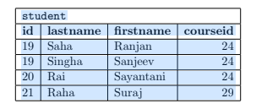
Refer to the following table student.
Consider:
SELECT * FROM student
WHERE lastname LIKE ’%a’;
What does above SQL statement select from the student table?
a) Selects all students with a lastname ending with ”a”.
b) Selects all students with a lastname starting with ”a”.
c) Selects all students with a lastname contains atmost one ”a”.
d) Selects all students with a lastname contains no ”a”.

Slide 9
Identify the tools that are used for executing SQL commands from a programming language.
a) JDBC
b) OpenCV
c) ODBC
d) OpenGL

Slide 10
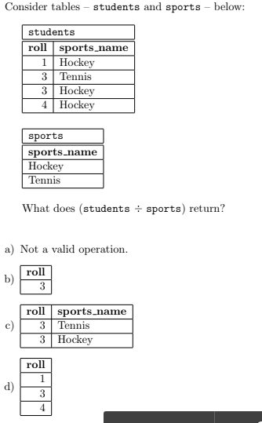

Slide 11
Consider the relation student(roll, name, dob, course, age) which stores the roll, name, date of birth, courses taken and age of the student. Students can take multiple courses. Two
students can have the same name. The attribute roll is unique for every student.
Identify the possible attribute type/s for name attribute.
a) Multi-valued attribute
b) Derived attribute
c) Composite attribute
d) Key attribute

Slide 12
Consider the relational database given below: Marks: 2 MCQ
employee(person name, street, city)
works(person name, company name, salary)
company(company name, city)
Identify the correct relational algebra expression for the query given below. Find the names and cities of residence of all employees who work for ‘UCO’.
a) Πperson name,city(employee Natural Join (σcompany name=“UCO”(works)))
b) Πperson name(employee Natural Join (σcompany name=“UCO”(works)))
c) Πperson name,city(σstreet=“Bidhan Sarani”(employee) Natural Join (σcompany name=“UCO”(works)))
d) Πperson name,city(σcity=“Kolkata”(employee) Natural Join (σcompany name=“UCO”(works)))

Slide 13
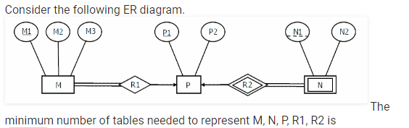
A)2
B)3
C)4
D) 5

Slide 14
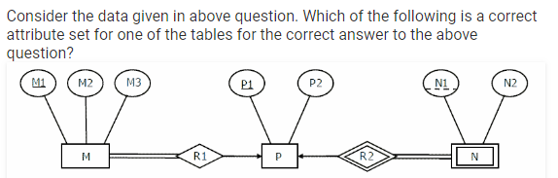
A) {M1, M2, M3, P1}
B) {M1, P1, N1, N2}
C) {M1, P1, N1}
D) {M1, P1}

